Slide 1
Smart Shopping Cart
Under guidance of
Mr. Sundaramahalingam
Assistant professor,
BIT,
Sathy.
Student 1 (191ae135 & Sakthi Sagar)
Student 2 (191ae123 & Mohamed sameer)
Student 3 (191ae128 & Ragunath)
Student 4 (191ae102 & Abishek)

Slide 2
Abstract
When we go shopping, we normally choose the items we need and place them in the shopping cart.However, when it comes to paying the bill payment, the mall does not have enough counters to handle all of the consumers. Scanning each and every product of every consumer becomes a massive process, resulting in long lines. We have modified a cart that will feature a barcode scanner by which the customer may scan the product and automatically the product id, product name, quantity, and other details are recorded in the Wamp database, which will be fetched and presented on the android app, keeping this in mind. Scanner will keep track of everything.Each cart has some unique ID, an android application will use this ID so that the database can be accessed by the user through Wi-Fi module. The mall's computer will display all the list of product added to the cart and the final bill will be generated. This application is based on android platform as most of the people use android phones.

Slide 3
Problem Statement Addressed
People used to have a list of items written in a piece of paper when they went shopping for groceries; however, the advancement of technology has changed how people do shopping over the last decade. In addition, the emergence of smart phone has changed the retail shopping experience drastically. The retailers are continuously working on improving the shopping experience to make sure their customers are satisfied in overall shopping experience.Now a days in the retail stores in India floating of customers are very high, for this floating the retail store the customer billing waiting time is high.

Slide 4
Existing Solution to the Problem Addressed
Person is required to read barcode on product. Barcode must be visible on the surface of product. Line of sight required to a read barcode. The readability of barcodes can be impaired by dirt, moisture, abrasion, or packaging contours Short reading distance. Barcode does not have READ & WRITE capability.
In 2005, Fujitsu, a Japanese company has demonstrated a shopping trolley with an inbuilt barcode scanner. The barcode scanner was used to scan both products and loyalty cards in real time

Slide 5
Proposed Solution to the Problem Addressed
Our proposed system creates an automated central bill system for supermarket and shopping malls. Using ABC (automated billing cart), customers do not have to wait in the queue at the billing counter. The system is designed such that products information is transferred to central billing system where customer can pay their bills easily. The system helps in the storage management with an efficient processing of the inventory on every purchase of an item. The smart shopping cart has the potential to make the shopping experience faster and easier. The main objective of this system is to reduce and eliminate time taken at the billing in super markets. This is done by designing an intelligent shopping cart which uses barcode scanner to allow users to self-checkout and increase productivity time. This system contains a barcode scanner which is mounted on the cart. The details about the products that are available in the mall are already stored in their database server.

Slide 6
Project Work Plan
A wireless smart-device (scanner) track the records of all the products that are brought i.e. an android application and the accountant system are linked with scanner. The smart cart can be implemented in the following way in the store.
Stage I Stocks from various suppliers arrive at the store. Products are added to the stock and are registered by using the product registration form, which has detailed information about the product like product_id, product_name, product_price, product_quantity, Brand name etc.
Stage II The customer arrives at the store. There can be two cases: If a new customer arrives to the store then he will move to the user registration counter. User will be registered first then he/she can take the smart cart and start shopping. If he/she is an old customer then he/she don’t need to register again, they can directly start shopping by smart cart and entering its unique cart identity number into the mobile application.
Stage III When the customer has done with the shopping, he/she will move forward along with the cart to the billing counter. Accountant does the authentication of the customer by entering the unique cart number and verifies the products that he has brought. A billing detail of the purchased products is automatically transferred to the server. The bill is computed and customer is provided with a facility to remove undesired products.
Hardware Requirements: ● Accountant system (PC). ● Android Mobile. ● Scanner. ● Wi-Fi module.
Software Requirements: ● Android Studio. ● My SQL, PHP. ● Wamp server.

Slide 7
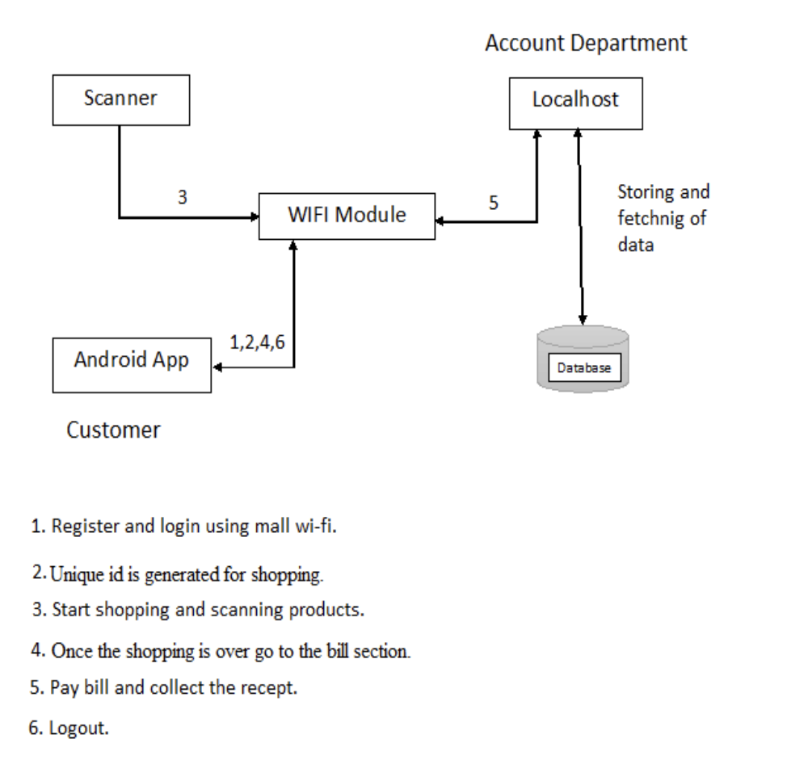
Block Diagram and/or Circuit Diagram

Slide 8
Effective utilization of the Modern Tool & Cloud
The movement of the cart can be made automatic by making use of sensors. In this way there is no need to pull heavy cart. Cart with LCD screens can be built which displays discount offers and total counting of the products then and there automatically. Also the LCD can be provided with a layout of the shopping market through which the customer can get the exact information of the products present at different places. Thus increasing the user friendliness. The communication medium can be replaced with Li-Fi which covers a large area for transmission of information, making it more efficient.

Slide 9
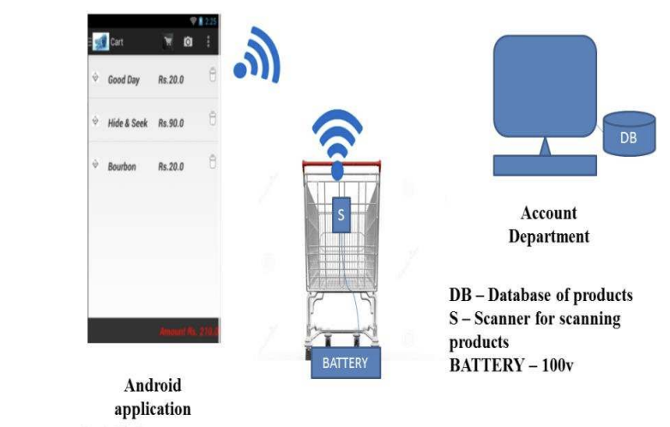
Technology stack & use case

Slide 10
References
[1] Ms. RupaliSawant, Kripa Krishnan, Shweta Bhokre, PriyankaBhosale, The RFID Based Smart Shopping Cart, March-April, 2015.
[2] UditaGangwal, Sanchita Roy, JyotsnaBapat, Smart Shopping Cart for Automated Billing Purpose using Wireless Sensor Networks, 2013.
[3] S. Sainath, K. Surender, V. VikramArvind, J. Thangakumar, Automated Shopping Trolley for Super Market Billing System, (ICCCMIT-2014).
[4] Ashmeet Kaur, AvniGarg, Abhishek Verma, Akshay Bansal, Arvinder Singh, Arduino based shopping cart.
[5] JanhaviIyer, HarshadDhabu, Sudeep K. Mohanty, Smart Trolley System for Automated Billing using zigbee, October 2015. [6] Vrinda Gupta, NiharikaGarg, Analytical Model for Automating

